Slide 1

AI & ML MINI PROJECT • PROJECT PRESENTATION
CAMPAIGN PERFORMANCE
PREDICTION & BUDGET
OPTIMIZATION SYSTEM
PREDICT.
OPTIMIZE.
EXPLAIN.
From campaign data
to actionable decisions
A machine-learning and constrained-optimization approach to smarter digital advertising budgets
Harishwaran K • 24619142
Mageshwaran H • 24619144
Keerthivarman M • 24619145
VISTAS, Pallavaram | October 2026
Guide: Mrs. V.P. Kanchana

Slide 2
Abstract
PROJECT OVERVIEW
Digital advertising performance changes with platform, campaign type, audience, timing and spend. This project combines historical campaign data, machine-learning prediction and constrained optimization in one workflow.
A Gradient Boosting regression model estimates expected revenue from campaign features. Platform response curves represent diminishing returns, while the SLSQP optimizer distributes a fixed budget subject to configured limits. A web dashboard presents predictions, recommended allocations and what-if comparisons.
The intended outcome is a more transparent, data-informed budget plan—not a guarantee of actual clicks, conversions or revenue.
PREDICT
Estimate expected campaign revenue.
OPTIMIZE
Allocate budget within constraints.
EXPLAIN
Show recommendations and what-if scenarios.
CAMPAIGN PERFORMANCE PREDICTION & BUDGET OPTIMIZATION SYSTEM
02 / 17

Slide 3
Problem Statement
PROBLEM CONTEXT
How should a limited advertising budget be distributed across channels when expected performance differs and returns may diminish as spend increases?
Fragmented evidence
Uncertain outcomes
Manual allocation
Historical campaign results, channel details and external factors may sit in separate datasets.
Clicks, conversions and revenue vary with campaign context, timing and budget.
A fixed budget must be divided while respecting channel limits and comparing trade-offs.
Project need: connect reliable data preparation, performance prediction and constraint-aware budget allocation.
CAMPAIGN PERFORMANCE PREDICTION & BUDGET OPTIMIZATION SYSTEM
03 / 17

Slide 4
Objectives
PROJECT GOALS
01
Prepare data
Predict revenue
Model response
02
03
Clean missing values, encode categories and create usable campaign features.
Train a Gradient Boosting regressor to estimate expected campaign performance.
Fit platform response curves to represent diminishing returns.
04
Compare channels
Optimize spend
Support decisions
05
06
Evaluate predicted outcomes across platforms and campaign contexts.
Allocate a fixed total budget under configured bounds and constraints.
Present predictions, allocations and what-if analysis in a dashboard.
CAMPAIGN PERFORMANCE PREDICTION & BUDGET OPTIMIZATION SYSTEM
04 / 17

Slide 5
Literature Survey
PRIOR RESEARCH • 1 OF 2
Authors / work
Problem focus
Approach
Limitation
Nuara et al. (2018; 2022)
Joint bid/budget optimization for PPC campaigns
Bandit-based learning for dynamic bid and daily-budget decisions.
Requires online feedback; more complex than offline planning.
Han & Gabor (2020)
Contextual bandits for advertising budget allocation
Uses context and prior outcomes to estimate payouts and allocate with Thompson Sampling.
Depends on contextual feedback and online settings.
Geng et al. (2021); Gigli & Stella (2024/25)
Automated bidding and performance-marketing optimization
Interpretable optimization and data-efficient bandit methods.
May require platform-specific deployment or continued exploration.
Common theme: dynamic allocation, contextual learning and feedback-driven decisions.
CAMPAIGN PERFORMANCE PREDICTION & BUDGET OPTIMIZATION SYSTEM
05 / 17

Slide 6
Literature Survey
PRIOR RESEARCH • 2 OF 2
Authors / work
Problem focus
Approach
Limitation
Amin et al. (2012)
Budget Optimization for Sponsored Search: Censored Learning in MDPs
Models limited-budget click maximization using censored auction observations.
Focused on sponsored search; multi-channel adaptation may be needed.
Li et al. (2024)
Multi-Channel Advertising Budget Allocation Using RL and Improved Differential Evolution
Combines reinforcement learning and improved differential evolution for long-term allocation.
More complex than an offline prediction-and-optimization pipeline.
Wang & Zareeihemat (2025)
Multi-channel Advertising Budget Allocation Using Q-learning and Mutual Learning-based ABC
Combines Q-learning with an enhanced artificial bee colony optimizer.
Depends on reward feedback and optimizer design; needs wider testing.
Our direction: a practical, offline pipeline that links prediction to a constrained allocation step.
CAMPAIGN PERFORMANCE PREDICTION & BUDGET OPTIMIZATION SYSTEM
06 / 17

Slide 7
Research Gap
MOTIVATION FOR THE PROPOSED APPROACH
Disconnected steps
Diminishing returns
Prediction and budget allocation are often treated as separate tasks.
A channel’s response to additional spend may not remain linear.
Operational constraints
Usability
Recommendations must satisfy total-budget and channel-bound limits.
Decision-makers need interpretable outputs and quick scenario comparison.
Research direction: unify historical-data prediction, response modelling and constrained budget optimization.
CAMPAIGN PERFORMANCE PREDICTION & BUDGET OPTIMIZATION SYSTEM
07 / 17

Slide 8
Existing System
CURRENT CHALLENGES IN CAMPAIGN PLANNING
Manual budget decisions
Separate analytics tools
Limited scenario testing
Teams rely on historical reports and experience to distribute spend.
Prediction, reporting and allocation may be handled in different workflows.
Comparing alternative channel allocations can take time and manual effort.
Limitations addressed by this project
• Limited consistency: data cleaning and feature preparation may differ between analyses.
• Hard to enforce constraints: manual allocations can exceed bounds or fail to use the planned total.
• Less transparent trade-offs: decision-makers may not see predicted outcomes for alternative budgets.
CAMPAIGN PERFORMANCE PREDICTION & BUDGET OPTIMIZATION SYSTEM
08 / 17

Slide 9
Proposed System
INTEGRATED PREDICTION-TO-OPTIMIZATION WORKFLOW
01
02
03
04
05
Historical data
Preprocess
Predict
Optimize
Present
Campaign, channel and context fields
Clean, encode and transform
Gradient Boosting revenue model
Response curves + SLSQP
Dashboard and what-if analysis
Core principle: estimate expected revenue first, then optimize the budget while respecting the total available amount and configured channel limits.
CAMPAIGN PERFORMANCE PREDICTION & BUDGET OPTIMIZATION SYSTEM
09 / 17

Slide 10
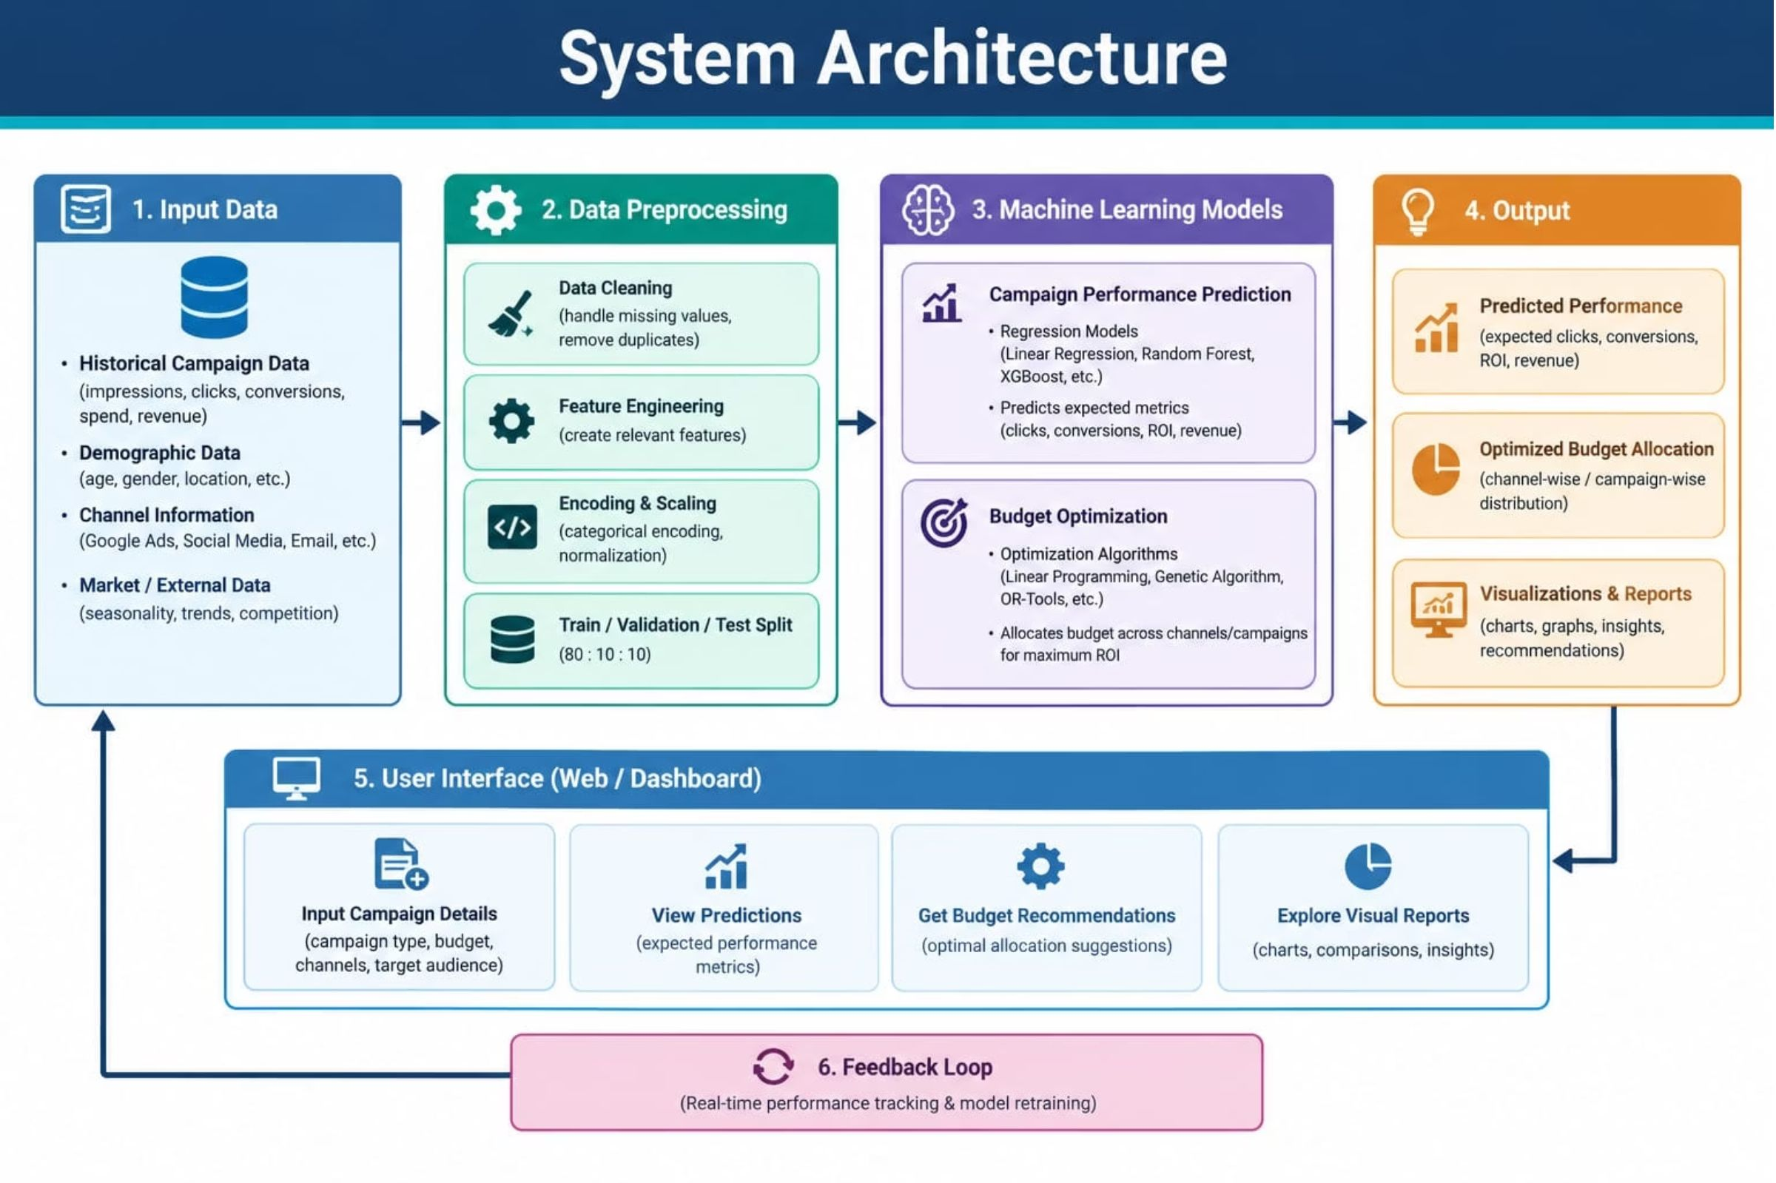
System Architecture
HIGH-LEVEL ARCHITECTURE • ATTACHED REFERENCE DIAGRAM
CAMPAIGN PERFORMANCE PREDICTION & BUDGET OPTIMIZATION SYSTEM
10 / 17

Slide 11
Methodology
STEP-BY-STEP IMPLEMENTATION
1. Data input
2. Data preprocessing
Load historical campaign CSV data and select relevant fields.
Handle missing values, encode categorical features and transform revenue if required.
3. Model training
4. Response curves
Train Gradient Boosting regression; use an 80/20 train-test split.
Fit platform-level response curves to model diminishing returns.
5. Budget optimization
6. Evaluation & interface
Use SLSQP to maximize predicted revenue within budget and channel constraints.
Review MAE, RMSE and R²; display predictions and what-if allocations in the dashboard.
CAMPAIGN PERFORMANCE PREDICTION & BUDGET OPTIMIZATION SYSTEM
11 / 17

Slide 12
Technology Stack
BASED ON THE PROJECT REFERENCE AND SUPPLIED IMPLEMENTATION NOTES
Frontend
Backend API
Data processing
React • Vite • Recharts
Python • FastAPI • Uvicorn
Pandas • NumPy • CSV
Web interface, dashboard charts and scenario views.
Serves prediction and optimization requests.
Data loading, cleaning and feature preparation.
Machine learning
Optimization
Deployment
Scikit-learn • Gradient Boosting • Joblib
SciPy • SLSQP
Cloud deployment
Revenue prediction and model persistence.
Constrained allocation across platforms/channels.
Hosts the web interface and API service.
Note: the reference website informs the product/interface context; exact production infrastructure is not publicly confirmed.
CAMPAIGN PERFORMANCE PREDICTION & BUDGET OPTIMIZATION SYSTEM
12 / 17

Slide 14
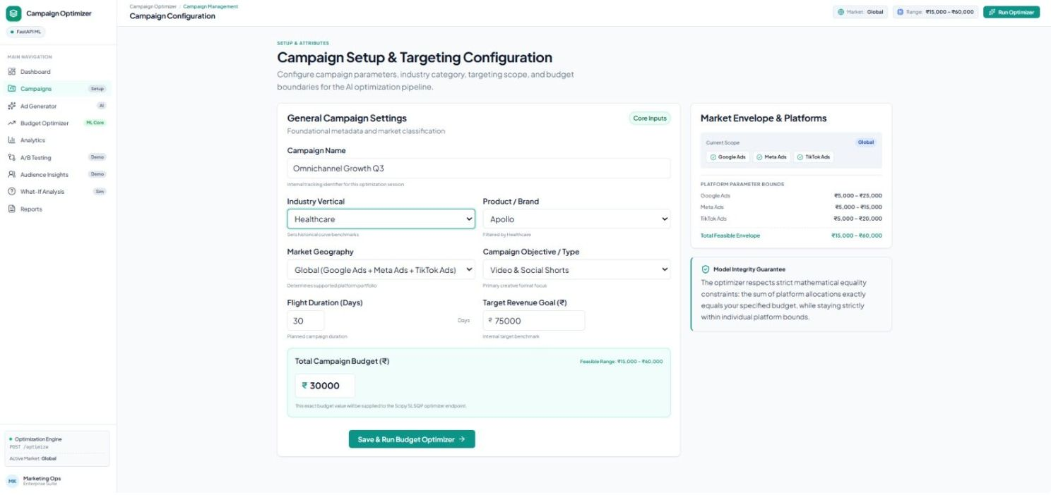
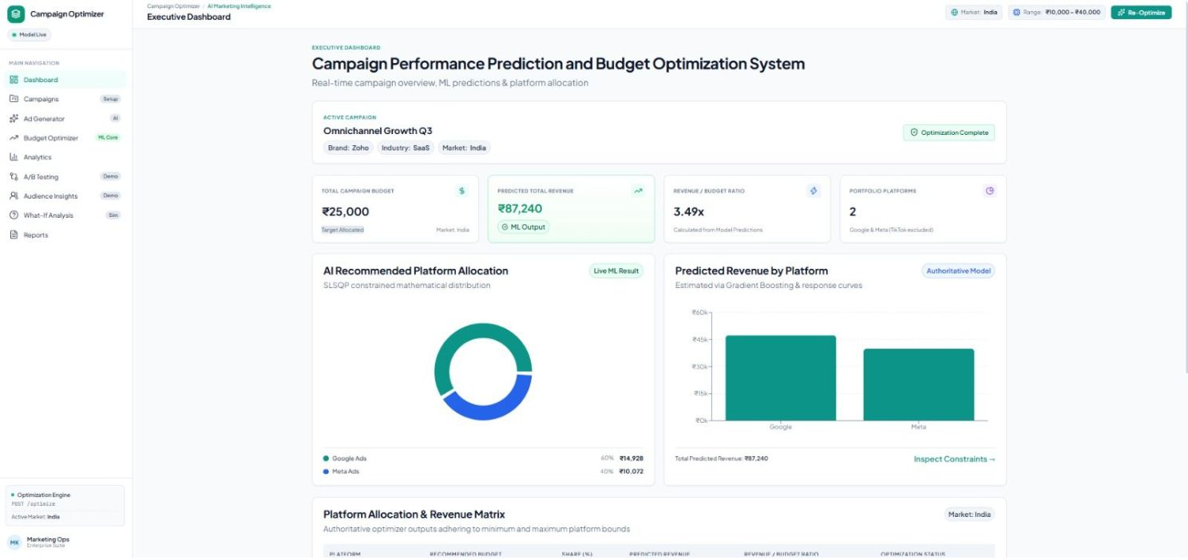
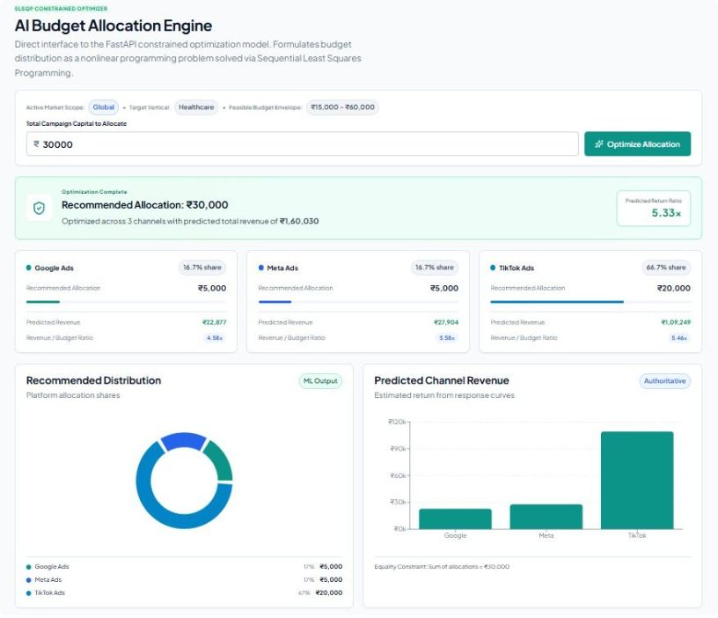
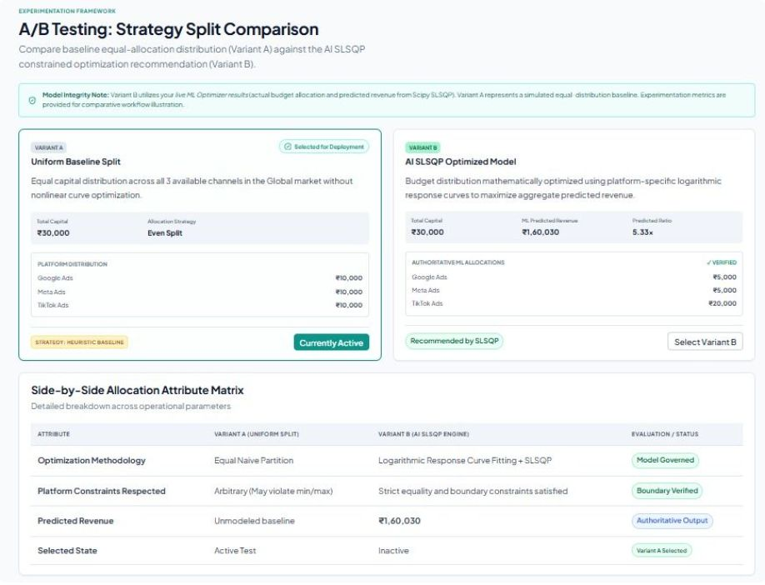
Setup to optimized budget
1 Campaign setup
2 Executive dashboard
3 AI budget allocation engine
4 A/B strategy split comparison
CAMPAIGN PERFORMANCE PREDICTION & BUDGET OPTIMIZATION SYSTEM
Notes:
Slide 1 of 2: campaign setup, executive dashboard, AI budget allocation engine and A/B strategy comparison.

Slide 15
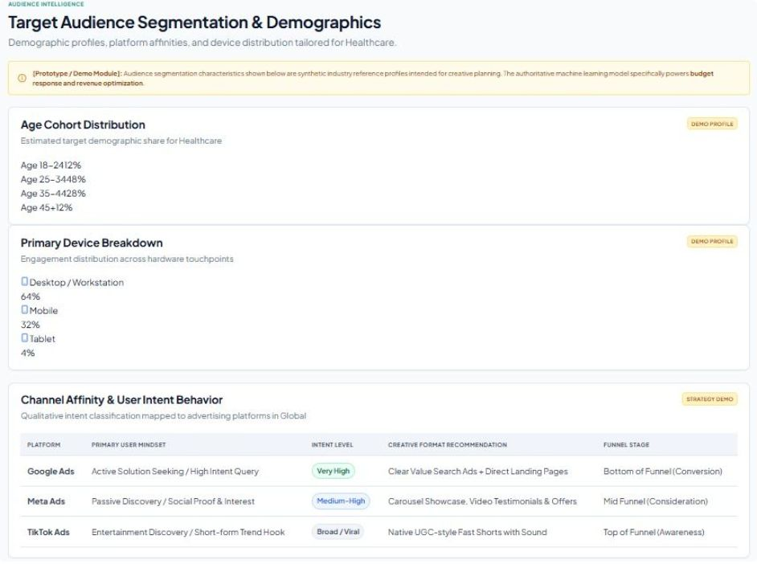
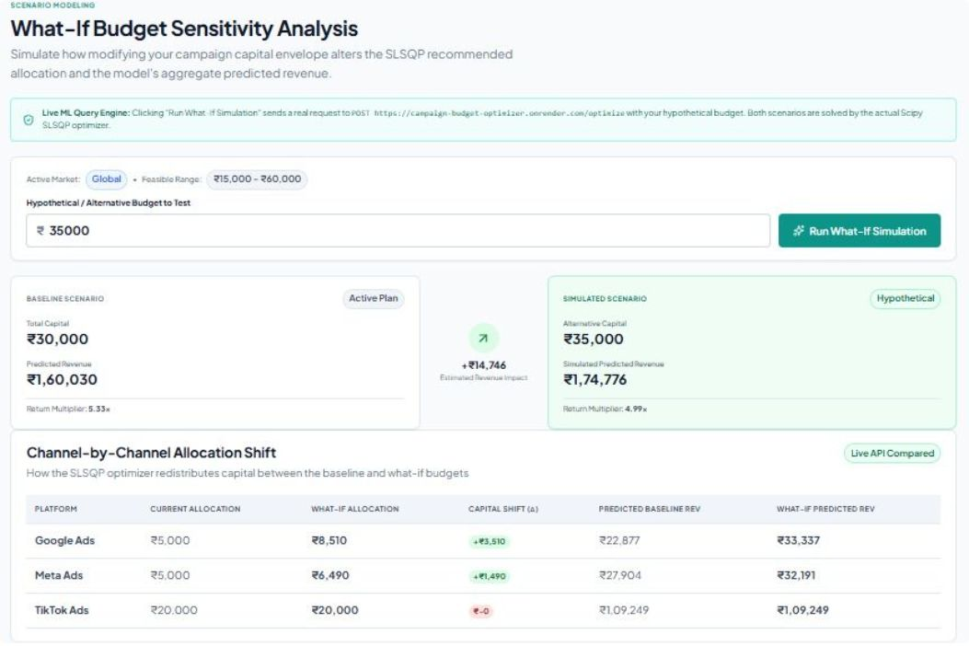
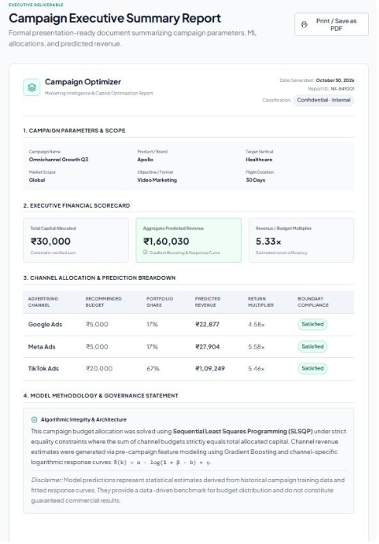
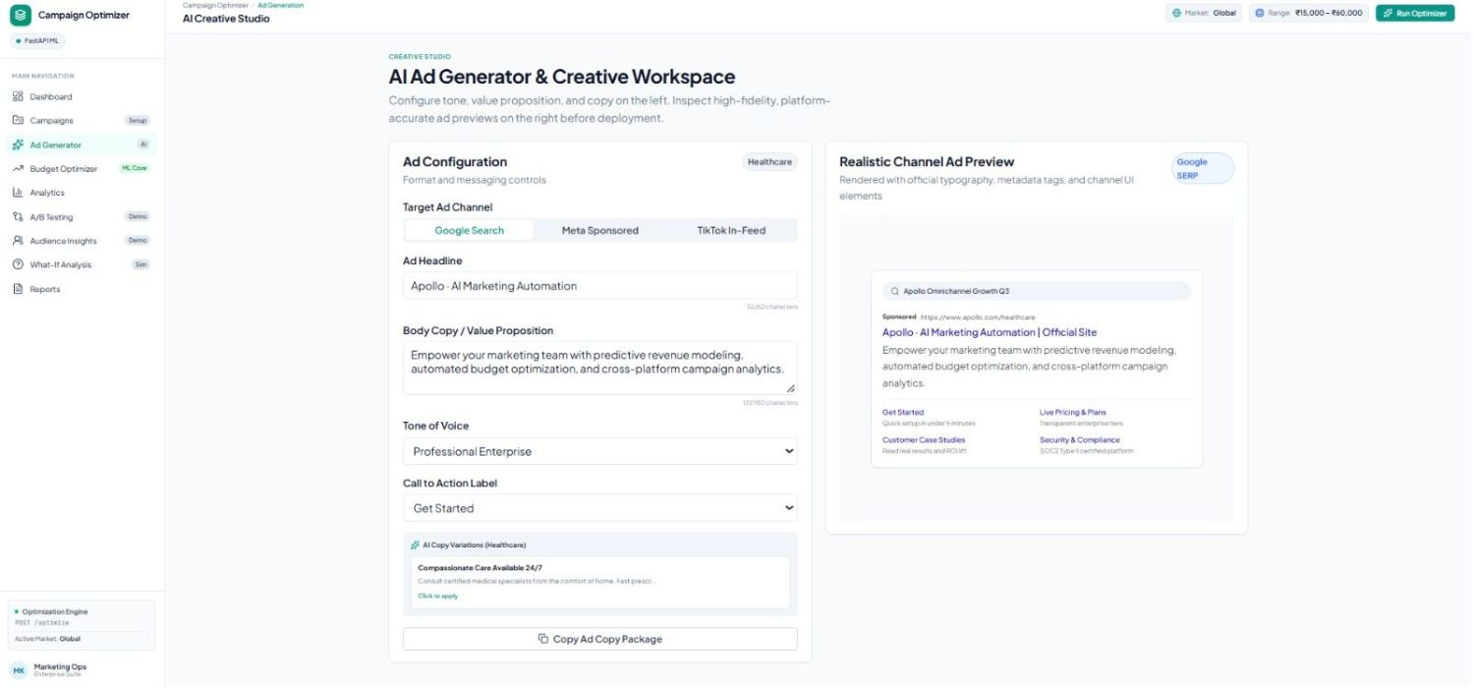
Audience, scenarios, reporting and creative
5 Audience segmentation
6 What-if budget sensitivity
7 Executive summary report
8 AI ad generator
CAMPAIGN PERFORMANCE PREDICTION & BUDGET OPTIMIZATION SYSTEM
Notes:
Slide 2 of 2: audience segmentation, what-if analysis, executive summary report and AI ad generator.

Slide 16
Future Enhancements
POTENTIAL NEXT STEPS
Live data integration
Advanced forecasting
Connect advertising APIs for fresher campaign performance data.
Explore time-series and deep-learning models where data supports them.
Adaptive optimization
Monitoring & alerts
Evaluate bandit-based methods when reliable feedback loops are available.
Add performance drift checks, budget alerts and scheduled evaluation.
Deployment scale
Decision transparency
Containerize services and consider autoscaling for higher usage.
Show assumptions, confidence and the reason behind each recommendation.
CAMPAIGN PERFORMANCE PREDICTION & BUDGET OPTIMIZATION SYSTEM
14 / 17

Slide 17
Conclusion
SUMMARY AND EXPECTED CONTRIBUTION
A unified workflow from historical campaign data to a budget recommendation.
Predict
Optimize
Communicate
Gradient Boosting estimates expected revenue from campaign context.
Response curves and SLSQP support budget allocation under constraints.
A dashboard helps compare predictions, recommended allocations and what-if scenarios.
Expected contribution: more consistent, explainable and constraint-aware budget planning. Actual impact must be validated using measured results.
CAMPAIGN PERFORMANCE PREDICTION & BUDGET OPTIMIZATION SYSTEM
15 / 17

Slide 18
References
SELECTED REFERENCES FROM THE SUPPLIED PRESENTATION
• Nuara et al. (2018; 2022). Joint bid/budget optimization for PPC campaigns. AAAI / related work.
• Han & Gabor (2020). Contextual bandits for advertising budget allocation. AdKDD.
• Geng et al. (2021). Automated bidding and performance-marketing optimization. Stanford GSB.
• Amin et al. (2012). Budget Optimization for Sponsored Search: Censored Learning in MDPs. PMLR.
• Li et al. (2024). Multi-channel advertising budget allocation using reinforcement learning and improved differential evolution. IEEE Access.
• Gigli & Stella (2024/25). Performance-marketing bandits.
• Wang & Zareeihemat (2025). Multi-channel advertising budget allocation using Q-learning and mutual learning-based artificial bee colony. Expert Systems with Applications.
• Scikit-learn documentation; SciPy documentation (curve fitting and SLSQP).
• Project reference: https://campaign-budget-optimizer-cznq.vercel.app
Bibliographic details are retained at the level provided in the source deck; verify full publication metadata before submission.
CAMPAIGN PERFORMANCE PREDICTION & BUDGET OPTIMIZATION SYSTEM
16 / 17

Slide 19
THANK YOU
PREDICT.
OPTIMIZE.
EXPLAIN.
Questions & discussion
Campaign Performance Prediction & Budget Optimization System
AI & ML Mini Project • VISTAS, Pallavaram

